Slide 2
Video Product Update
Chad Raymond

Slide 3
AGENDA
Predictions Review
3rd GigE
Programming Survey
New Channels, HD, 4K
New Ad Insertion Zone
Higher Bit Rate for some HD
Programming
Iowa High School Sports Network
Marquee Sports Network
OTA Direct Feeds
IPTV Converted
Streaming Services

Slide 4
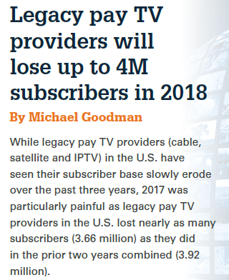
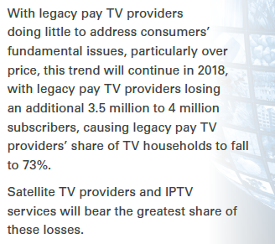
FIERCE VIDEO PREDICTIONS:
PREDICTION FROM 2018
This Trend Should Terrify
Big Pay-TV Companies
Adam Levy at The Motley Fool
Aug 26, 2018

Slide 5
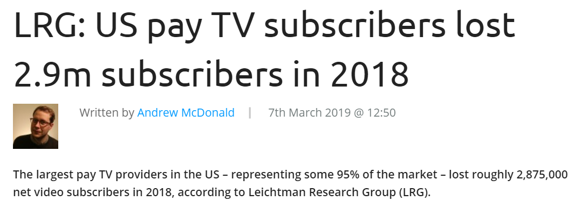
PREDICTION FROM 2018:
THE REALITY
LRG: US pay TV subscribers lost 2.9m subscribers in 2018
Andrew McDonald at DigitalTV.com
March 7, 2019

Slide 6
3rd GigE
Programming Survey
A new Programming Survey will be sent out before the end of September
Focus of survey will be on new content

Slide 7
3rd GigE
Round out our HD selection
Likely to add around 40 HD versions of channels that are already available in SD including the Premium movie suites

Slide 8
3rd GigE
New Ad Insertion Zone
Instead of providing the same ads across all of Iowa, ICAN will craft two zones for Aureon, which should make much of the advertising more relevant to your subscriber’s location.
Increased Bit Rate HD
Some HD channels with faster action, primarily sports, will be adjusted to a higher bit rate. Final determination of the bit rate has not been made and may possibly be done in steps.

Slide 9
NEW CONTENT
Exciting Announcement
Aureon has executed an agreement to provide the high school quarter final and semi-final games made available by the Iowa High School Sports Network.

Slide 10
NEW CONTENT
Available Games
The Iowa High School Boy’s State Football Semi-Finals - Twelve (12) games
The Iowa High School Boy’s Wrestling Semi-Finals - Two (2) sessions
The Iowa High School Boy’s State Basketball Quarter-Finals - Sixteen (16) games
The Iowa High School Boy’s State Basketball Semi-Finals - Eight (8) games

Slide 11
4K CONTENT
SES platform is active in our lab
Around a dozen channels from a few different content providers
Throughput rates between 12-25 Mbps

Slide 12
4K CONTENT
No dramatic shifts in the marketplace
Subscriber demand seems stagnant or even lower
Aureon is monitoring available content, especially sports, with an eye on possibly launching in 2020.
Here’s how and where you can watch the best 4K content
Josh Levenson at Digital Trends
Aug 12, 2019
4K

Slide 13
OTA DIRECT FEEDS
Aureon currently has one direct feed for over-the-air broadcasters:
Coordinating with broadcasters and other TV providers
Working on multiple DMAs
Still the most-watched channels
OTA

Slide 14
IPTV CONVERTED
“IPTV Converted” allows the ITC to take the current Aureon IPTV signal and convert it for use with different kinds of deployments. It offers:
Affordability
Reliability
A deep channel selection
Scalability
Convenience
Currently, there is one System Operator converting the DET IPTV signal into RF for use on coax (all of the conversion is done at the System Operator’s CO) and another who is good to go pending Content Provider authorization.
Aureon IPTV Converted allows you to reduce capital and operational costs while providing a high-quality video signal for your TV subscription service.

Slide 15
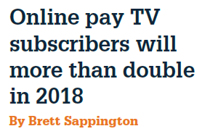
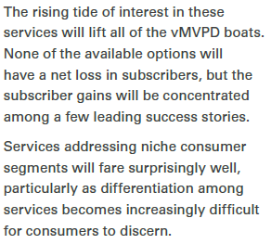
FIERCE VIDEO PREDICTIONS:
PREDICTION FROM 2018
excerpt

Slide 16
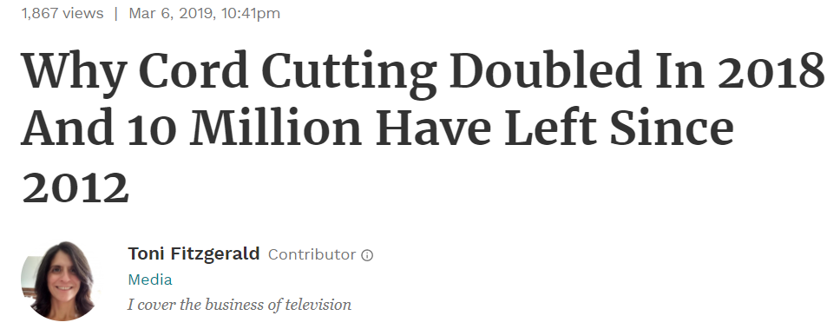
PREDICTION FROM 2018:
THE REALITY
Why Cord Cutting Doubled In 2018 And 10 Million Have Left Since 2012
Toni Fitzgeralrd at Forbes
March 6, 2019

Slide 17
STREAMING SERVICES
Aureon may offer an adaptive bit rate signal in 2020.
Going through 2020 budgeting process
Innovative’s Innocryption
Configured for testing in the Aureon video lab
Other possible options include:
MobiTV
Harmonic

Slide 18
FIERCE VIDEO PREDICTIONS:
PREDICTION FROM 2018
excerpts

Slide 19
PREDICTION FROM 2018:
THE REALITY
Disney Plus: Launch dates, prices, shows and movies to expect
Mike Sorrentino, Joan E. Solsman at c|net
Sept 3, 2019

Slide 20
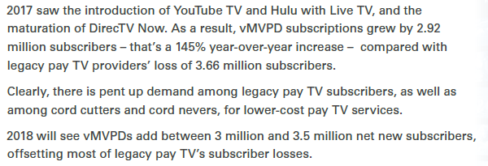
FIERCE VIDEO PREDICTIONS:
PREDICTION FROM 2018
excerpt

Slide 21
PREDICTION FROM 2018:
THE REALITY
Pay TV Subscribers Decline for 4th Consecutive Quarter
Michael Goodman at Strategy Analytics | June 12, 2019

Slide 22
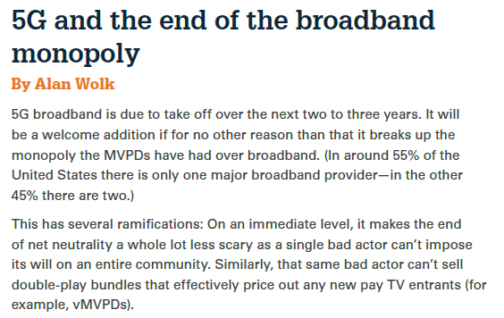
FIERCE VIDEO PREDICTIONS:
PREDICTION FROM 2018
When Is 5G Coming to the US? (Updated for 2018)
Tim Fisher at Lifewire
Sept 4, 2018

Slide 23
PREDICTION FROM 2018:
THE REALITY
In Search of 5G Spectrum – The Long and Short of It
Bob Wallace at Network Computing May 28, 2019

Slide 24
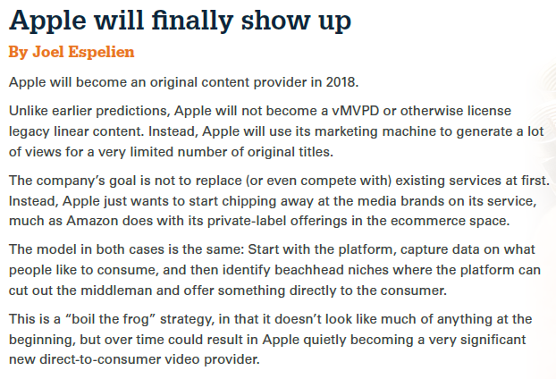
FIERCE VIDEO PREDICTIONS:
PREDICTION FROM 2018
Stream of Articles about Apple’s new video content
Verge Staff at The Verge
Last updated Aug 23, 2018

Slide 25
PREDICTION FROM 2018:
THE REALITY
Apple TV Plus: Everything to know about Apple's planned streaming service
Joan E. Solsman at c|net
Aug 26, 2019

Slide 26
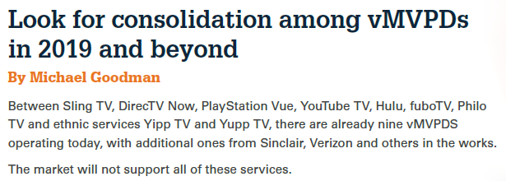
FIERCE VIDEO PREDICTIONS:
PREDICTION FROM 2018
vMVPDs Are Getting More Expensive; Here's Why Consumers Might Be OK With That
Alan Wolk at Forbes
June 30, 2018

Slide 27
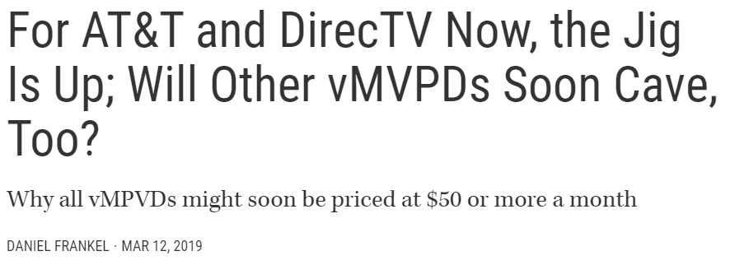
PREDICTION FROM 2018:
THE REALITY
For AT&T and DirecTV Now, the Jig Is Up; Will Other vMVPDs Soon Cave, Too?
Daniel Frankel at MultiChannel News Mar 12, 2019

Slide 28
ITCs HAVE THE ANSWERS
Aureon has questions and ITCs have the answers
ITCs will receive a DET Programming Survey before the end of September
Your feedback is crucial to the future success of this product

Slide 29
QUESTIONS?
Chad Raymond
chad.raymond@aureon.com
515-830-0367

